Slide 1
Company Overview
Company Description
Revenue Distribution, 2016
Ferrari N.V. is an industry leader for luxury vehicles and is well known for their Formula One performance and exclusivity.
Ferrari has also expanded into other markets, including clothing apparel, watches, video games, and they also own the world’s largest indoor theme park in Abu Dhabi.
Notable Shareholders: Exor N.V. (23.5%), Piero Ferrari (10.0%), and the General Public (57.4%).
Key Statistics
Stock Performance
Market Data |  |  | Value
Current Price | $71.89 |  | EV/EBITDA | 13.8x
Market Cap. | 1,358.2M |  | EV/Sales
Annual Dividend | $0.64 |  | Price/Book
Dividend Yield | 0.88% |  | Price/Earnings
FCF per Basic Share | $3.82 |  | PEG | 2.2x
Operations |  |  | Capital Structure
Revenue | 3,293.8M |  | Debt | 1,960.4M
EBITDA Margin | 27.1% |  | Cash & Equivalents | 457.8M
Operating Margin | 19.2% |  | Quick Ratio | 0.52x
Net Profit Margin | 13.3% |  | Current Ratio | 0.54x
4
Sources: Bloomberg, Yahoo Finance, Company 10-K

Slide 2
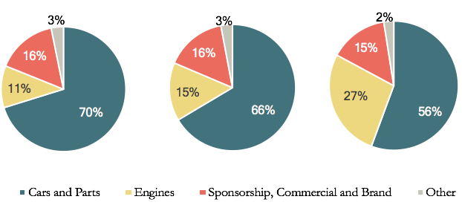
Operations
Sample of New Car Models
Car Units Sold
LaFerrari Aperta- The Aperta, the spider-version of the Laferrari, honors Ferrari’s 70th Anniversary
812 Superfast- A V12 version of the Berlinetta, the Superfast will commemorate Ferrari’s 70th Anniversary
GTC4 Lusso T- A 3.9-liter turbocharged V8 meant to be a daily driver
Ferrari N.V. 2016 Annual Report
Geographic Breakdown of Revenue
Breakdown of Revenues
2016A
2017E
2019E

Slide 3
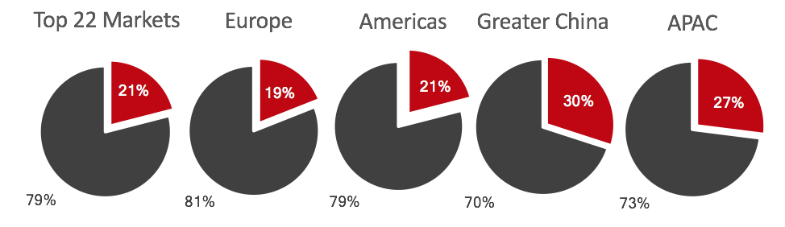
Executives and Initiatives
Key Executives
Growth Initiatives
Name | Position
Sergio Marchionne | CEO, Executive Director, Chairman, CEO of FCA
Piero Ferrari | Vice-Chairman, Non-Executive Director
John Elkann | Vice-Chairman, Non-Executive Director, CEO of EXOR, Chairman of FCA
Piero Ferrari | Vice-Chairman, Non-Executive Director
Increase car production
Reduce material costs
Reduce currency hedges
Slowed R&D expenses
Growth in foreign markets
Release specialty cars to drive demand
Luxury Car Market Performance
Strong 4Q 2016 Performance
Growth in engine sales
Attributed to success of Maserati and Alfa Romeo sales
Highest-earning quarter in past two years
Higher than predicted EPS
Increased margins from previous quarters
Reduced hedging losses
Ferrari is a market leader in Italy, USA, China, Japan, Australia, New Zealand, Indonesia, Singapore, and Thailand.
7
Sources: Company Q2 Transcript, 8-K, Investor Preseentation

Slide 5
Operations
Flight Systems
By the Numbers
Operational Activities
Rocket Propulsion Systems
Satellites & Other Subsystems
Missile Defense Interceptors and Target Systems
Medium-Caliber Gun Systems
Small Research Rockets & Scientific Balloons
Small & Medium Caliber Ammunition
Figures
Over 16,000 motors
More than 1,000
More than 300
15,000 units installed
30 missions/year
8 billion since 2011
Breakdown of Revenues
5
Sources: Company 10-K

